Slide 1
Intro to Reinforcement Learning By Richard Sutton
Chapter 7
n-step Bootstrapping

Slide 2
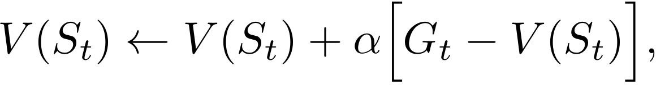
Recap: MC vs TD
Monte Carlo: wait until end of episode
MC error
Return
1-step TD / TD(0): wait until next time step
TD error
Bootstrapping target

Slide 3
n-step Bootstrapping
Perform update based on intermediate number of rewards
Freed from the “tyranny of the time step” of TD
Different time step for action selection (1) and bootstrapping interval (n)
Called n-step TD since they still bootstrap

Slide 4
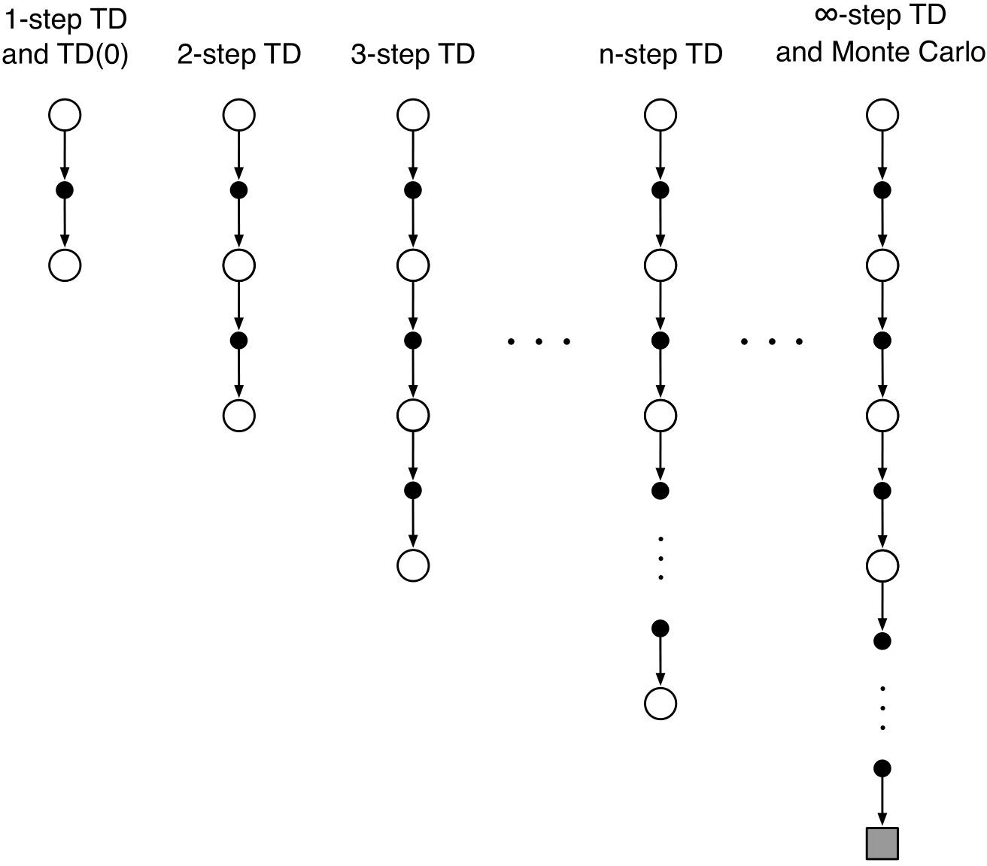
n-step Bootstrapping

Slide 5

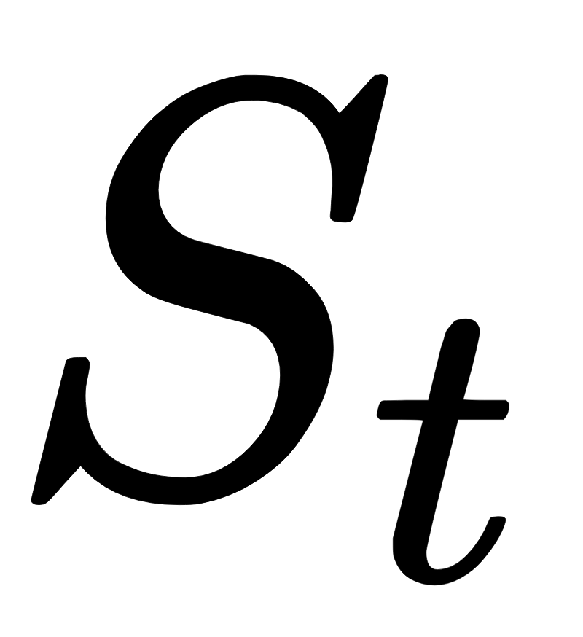
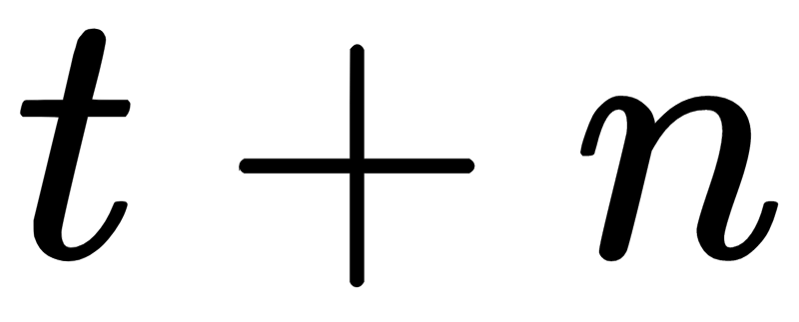
n-step TD Prediction
Use truncated n-step return as target
Use n rewards and bootstrap
Needs future rewards not available at timestep
cannot be updated until timestep

Slide 6
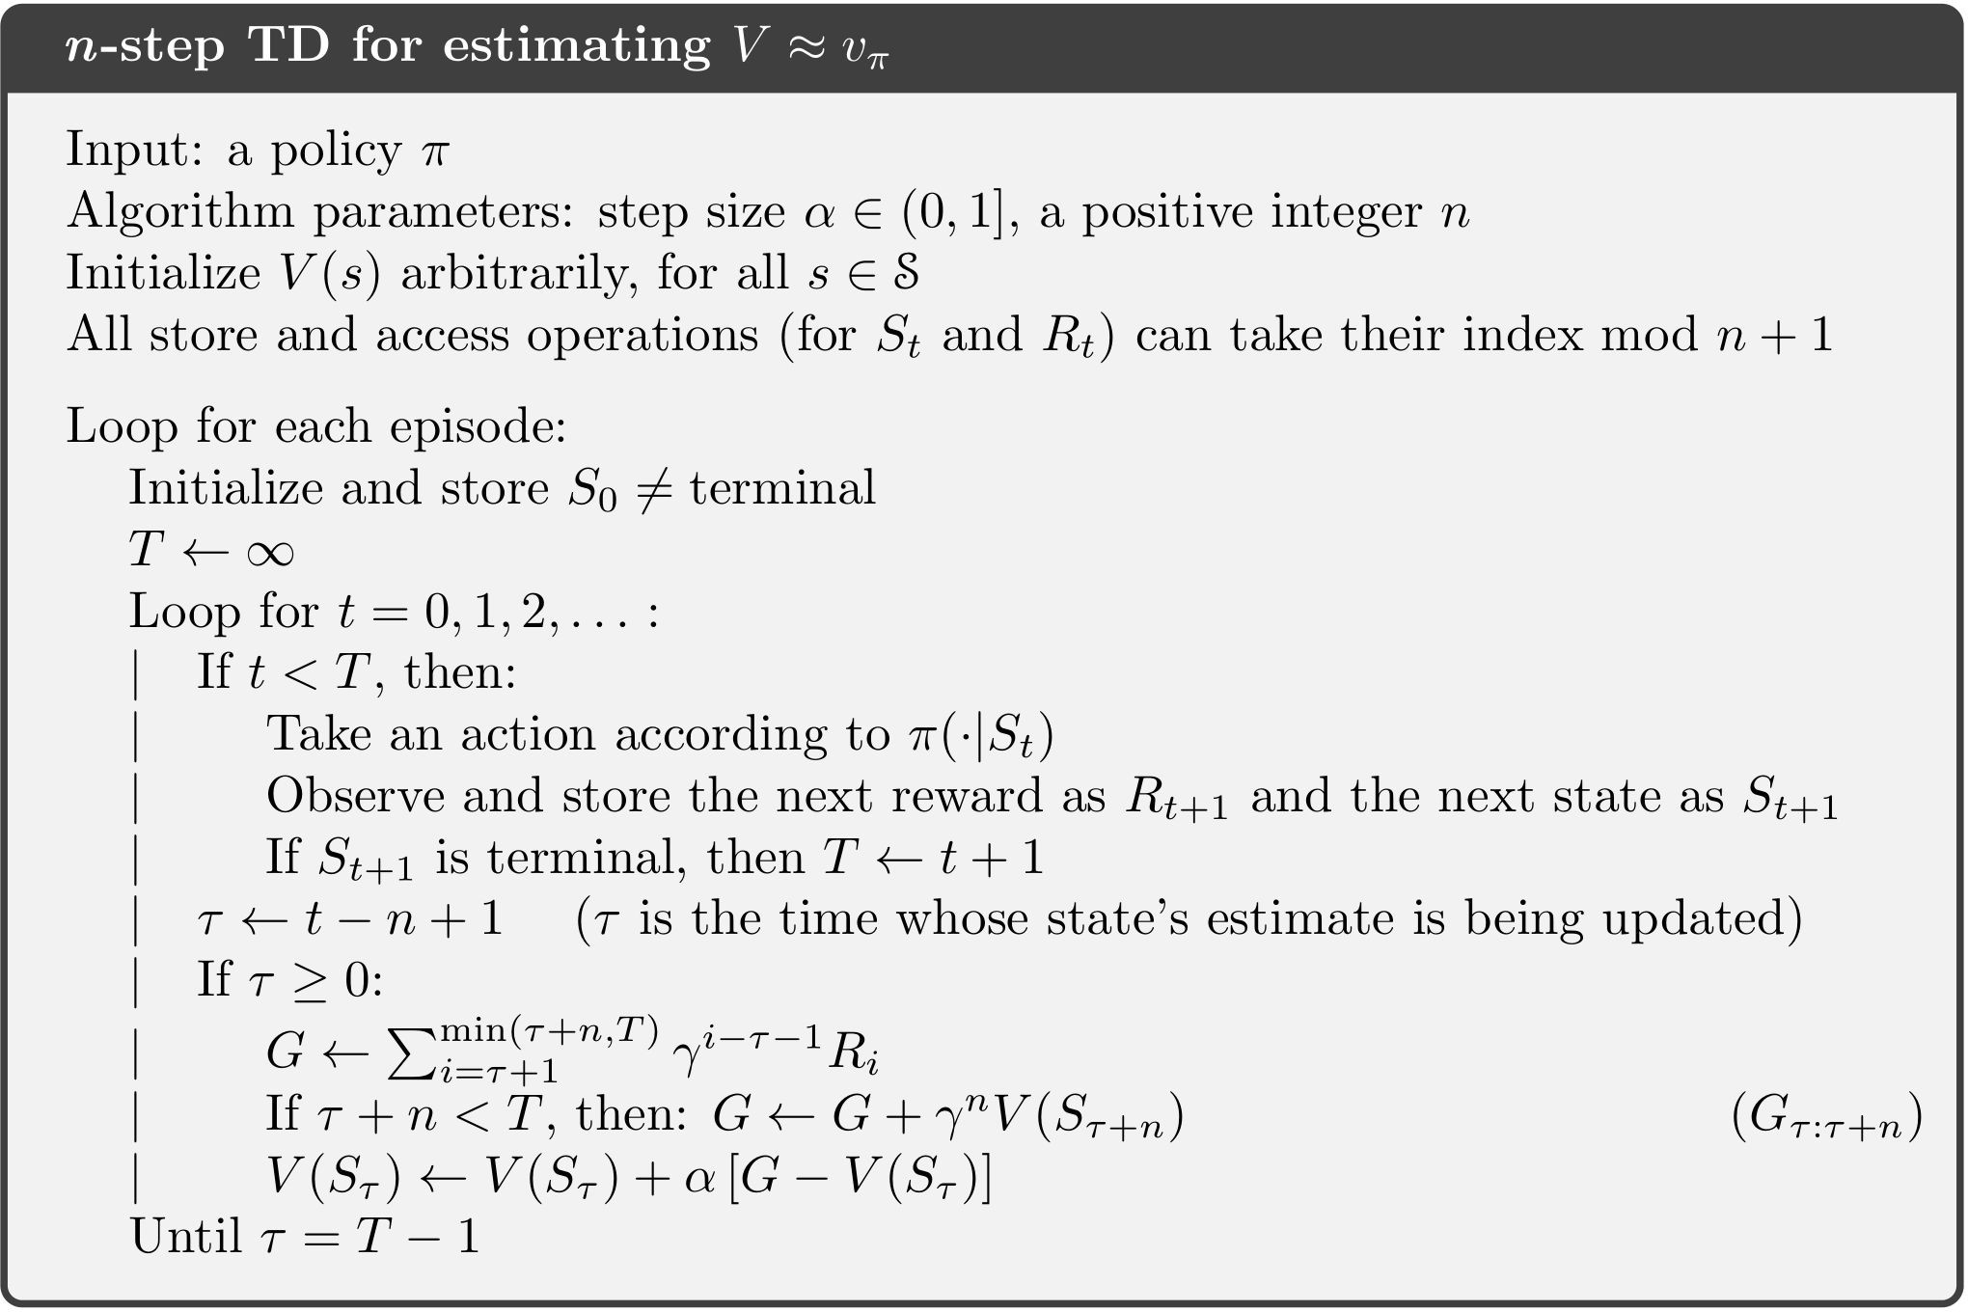
n-step TD Prediction: Pseudocode
Compute n-step return
Update V

Slide 7
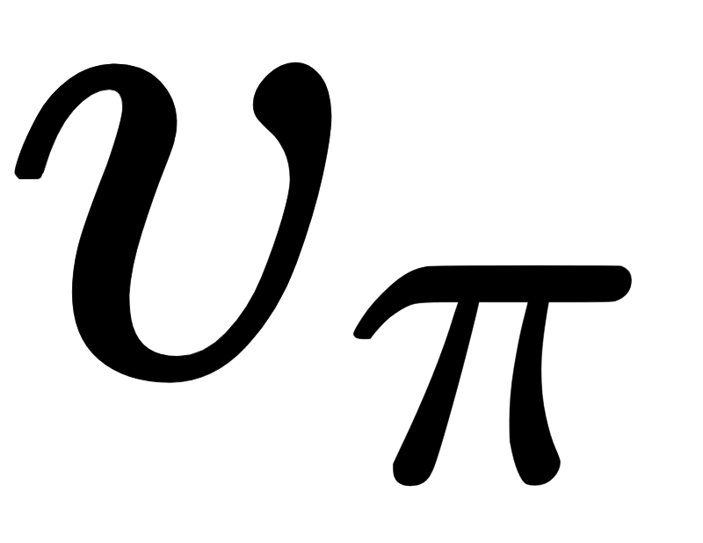
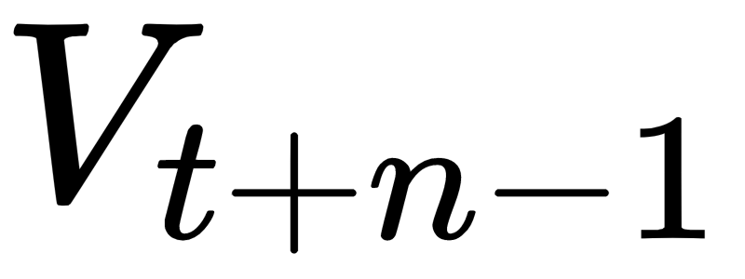
n-step TD Prediction: Convergence
The n-step return has the error reduction property
Expectation of n-step return is a better estimate of than
in the worst-state sense
Converges to true value under appropriate technical conditions

Slide 8
Random Walk Example
Rewards only on exit (-1 on left exit, 1 on right exit)
n-step return: propagate reward up to n latest states
Sample trajectory
1-step
2-step
S1
S2
S3
S17
S18
S19
R = -1
R = 1

Slide 9
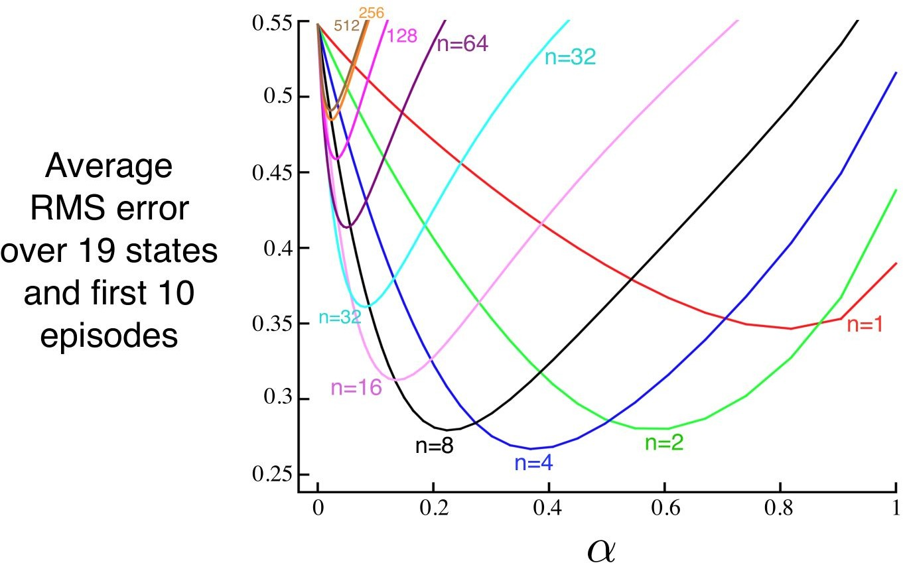
Random Walk Example: n-step TD Prediction
Intermediate n does best

Slide 10
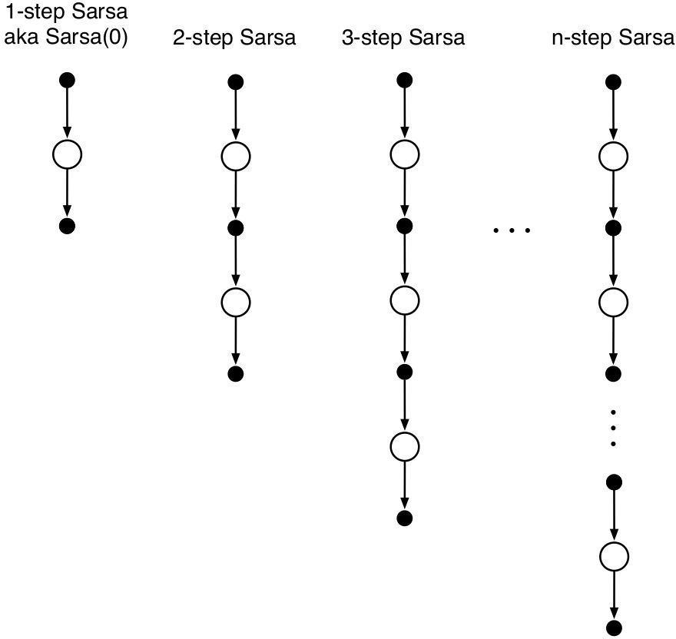
n-step Sarsa
Extend n-step TD Prediction to Control (Sarsa)
Need to use Q instead of V
Use ε-greedy policy
Redefine n-step return with Q
Naturally extend to Sarsa

Slide 11
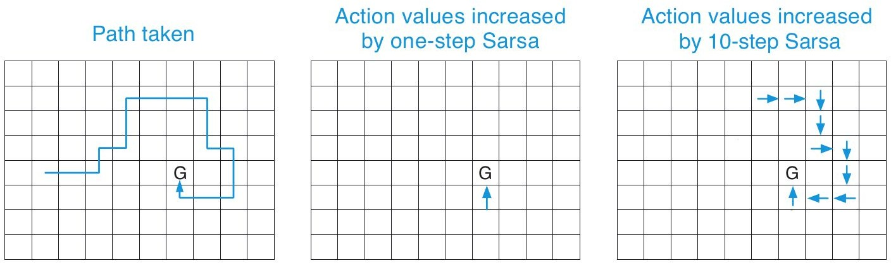
n-step Sarsa vs. Sarsa(0)
Gridworld with nonzero reward only at the end
n-step can learn much more from one episode

Slide 12
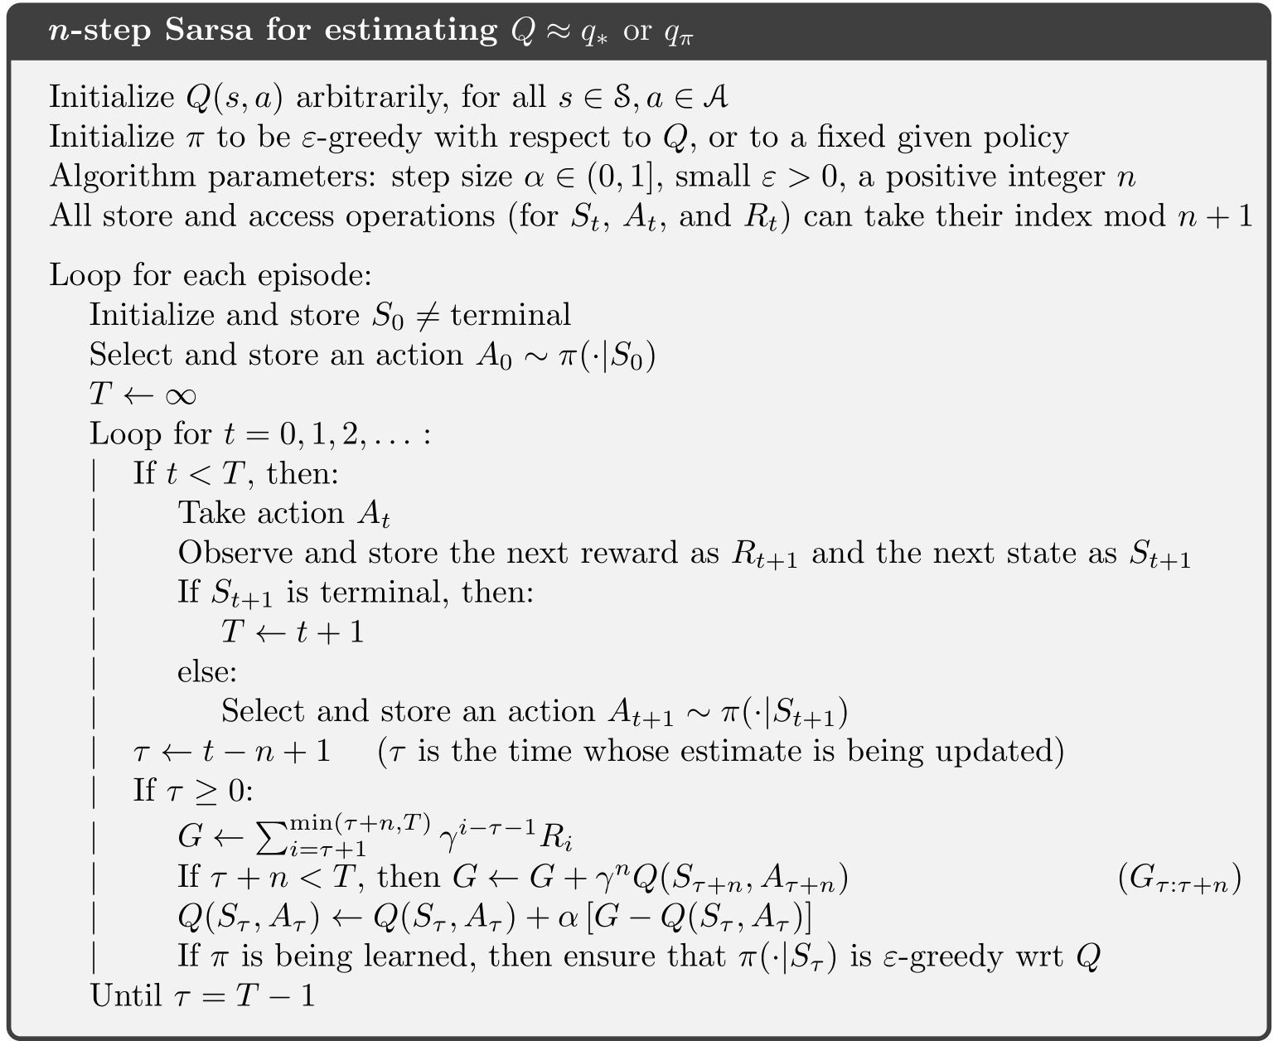
n-step Sarsa: Pseudocode

Slide 13
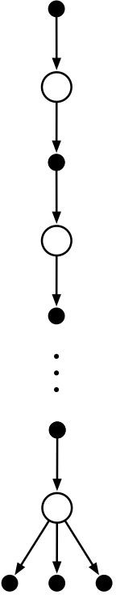

n-step Expected Sarsa
Same update as Sarsa except the last element
Consider all possible actions in the last step
Same n-step return as Sarsa except the last step
Same update as Sarsa

Slide 14
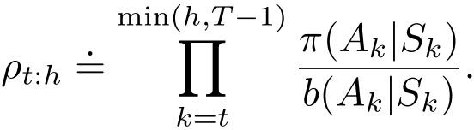

Off-policy n-step Learning
Need importance sampling
Update target policy’s values with behavior policy’s returns
Generalizes the on-policy case
If , then

Slide 15

Off-policy n-step Sarsa
Update Q instead of V
Importance sampling ratio starts one step later for Q values
is already chosen

Slide 16
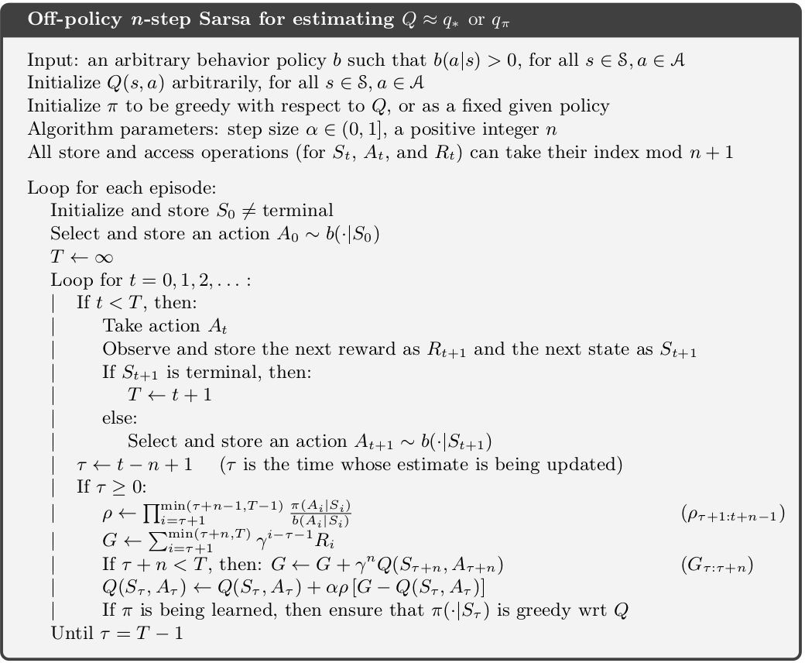
Off-policy n-step Sarsa: Pseudocode

Slide 17
Off-policy n-step Expected Sarsa
Importance sampling ratio ends one step earlier for Expected Sarsa
Use expected n-step return

Slide 18





Per-decision Off-policy Methods: Intuition*
More efficient off-policy n-step method
Write returns recursively:
Naive importance sampling
If ,
Estimate shrinks, higher variance

Slide 19

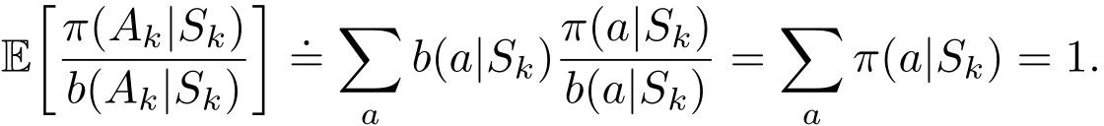
Per-decision Off-policy Methods*
Better: If , leave the estimate unchanged
Control Variate
Expected update is unchanged since
Used with TD update without importance sampling

Slide 20
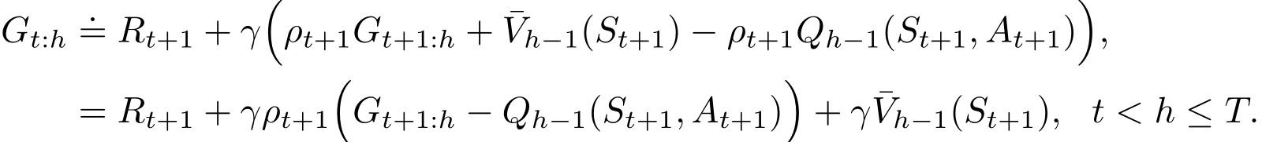
Per-decision Off-policy Methods: Q*
Use Expected Sarsa’s n-step return
Off-policy form with control variate:
Analogous to Expected Sarsa after combining with TD update algorithm
http://auai.org/uai2018/proceedings/papers/282.pdf

Slide 21
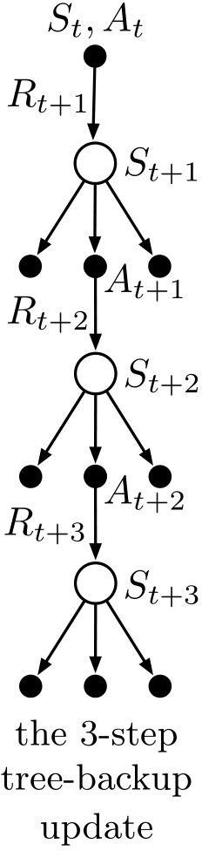



n-step Tree Backup Algorithm
Off-policy without importance sampling
Update from entire tree of estimated action values
Leaf action nodes (not selected) contribute to the target
Selected action nodes does not contribute but weighs all next-level action values

Slide 22
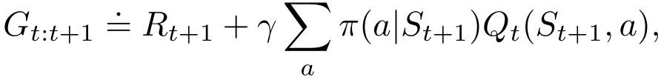
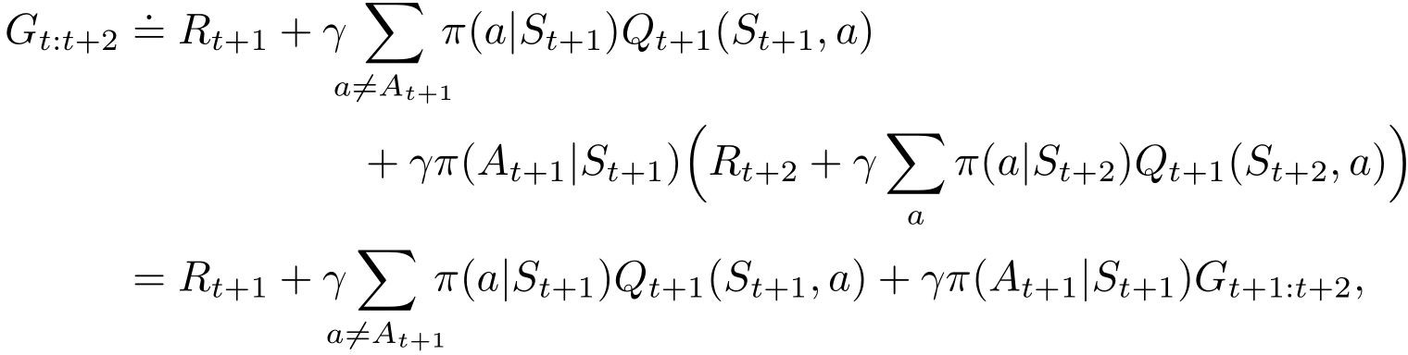
n-step Tree Backup Algorithm: n-step Return
1-step return
2-step return

Slide 23
n-step Tree Backup Algorithm: n-step Return
2-step return
n-step return

Slide 24
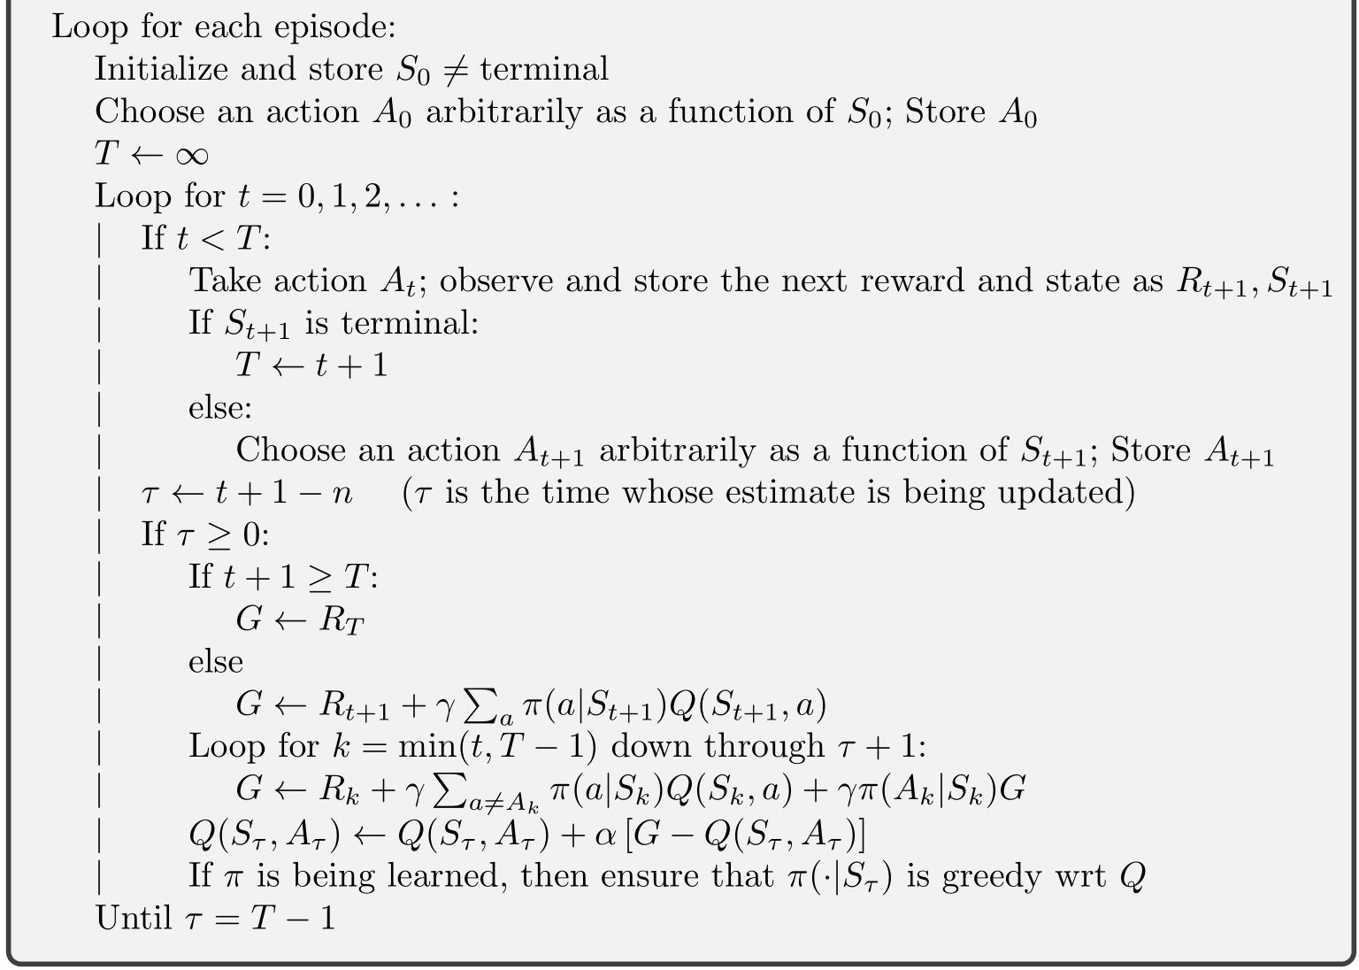
n-step Tree Backup Algorithm: Pseudocode

Slide 25
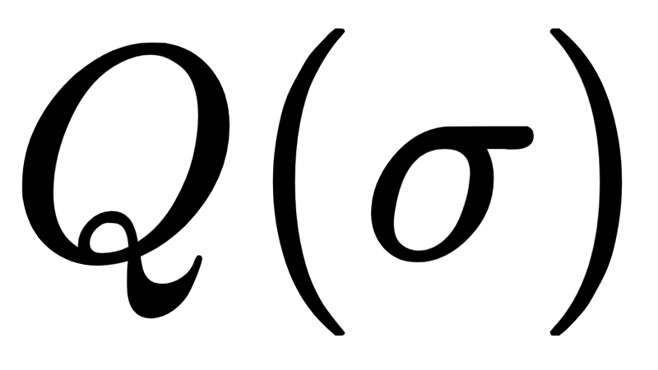
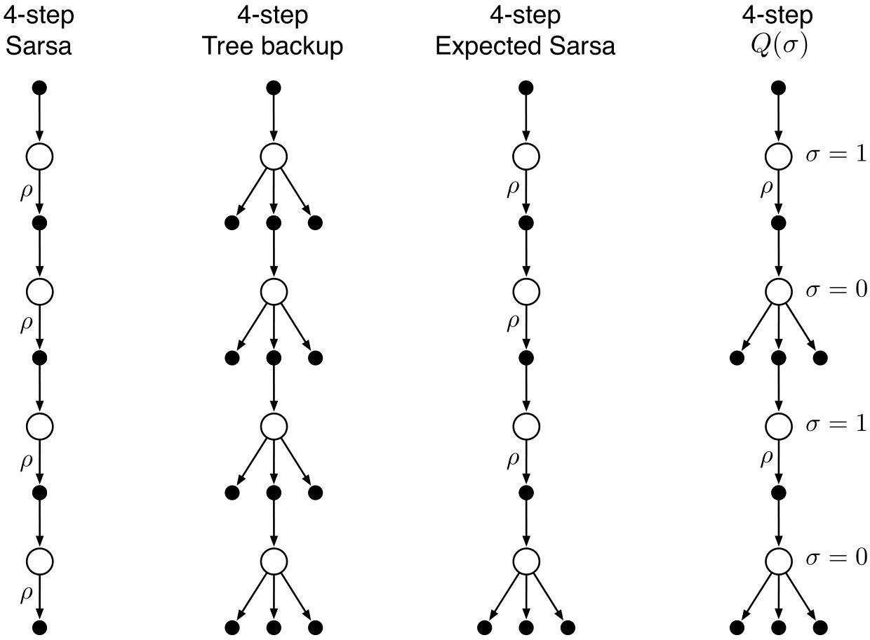
A Unifying Algorithm: n-step *
Unify Sarsa, Tree Backup and Expected Sarsa
Decide on each step to use sample action (Sarsa) or expectation of all actions (Tree Backup)

Slide 26


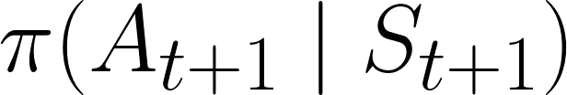
A Unifying Algorithm: n-step
: Equations*
: degree of sampling on timestep t
Slide linearly between two weights:
Sarsa: Importance sampling ratio
Tree Backup: Policy probability

Slide 27
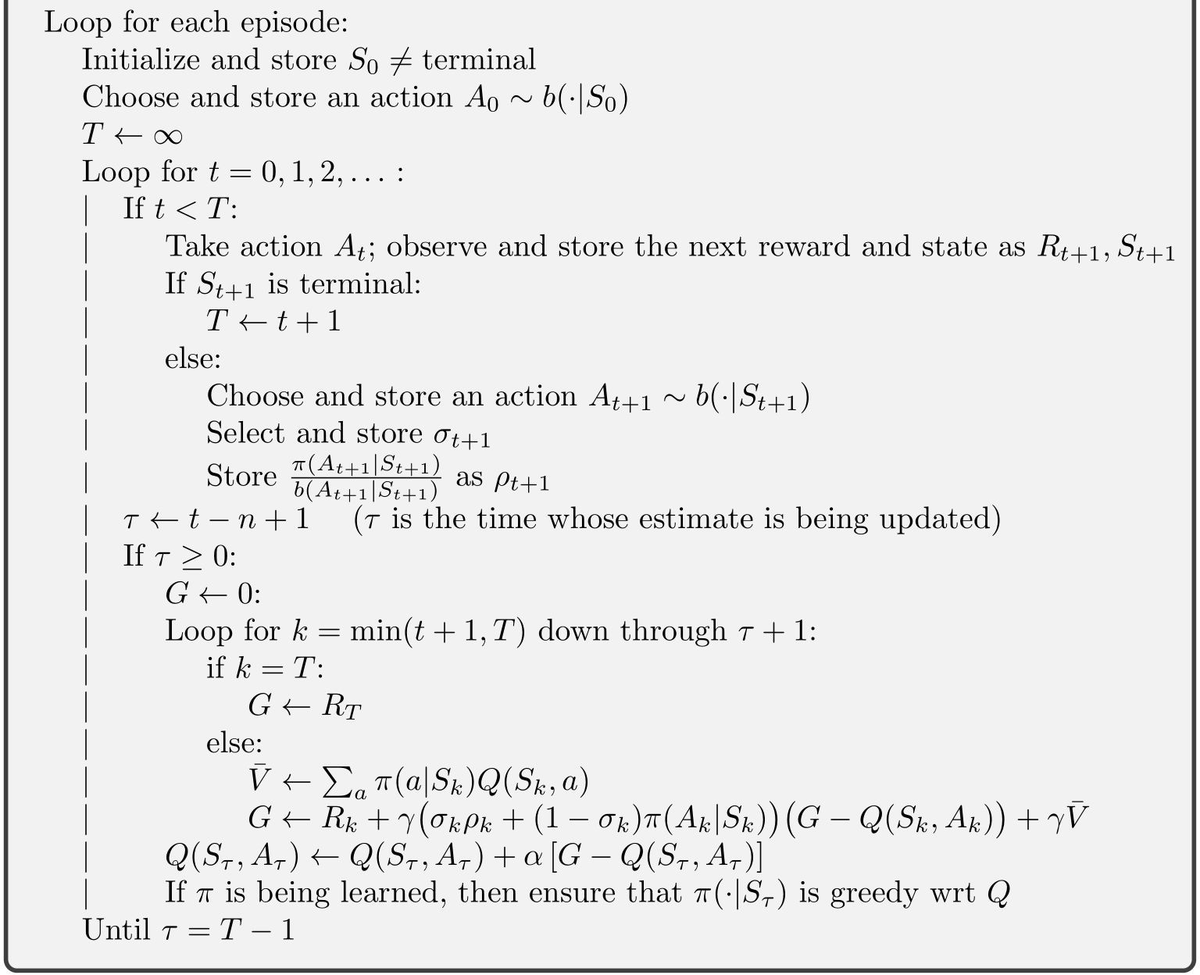
: Pseudocode*
A Unifying Algorithm: n-step

Slide 28
Summary
n-step: Look ahead to the next n rewards, states, and actions
+ Perform better than either MC or TD
+ Escapes the tyranny of the single time step
Delay of n steps before learning
More memory and computation per timestep
Extended to Eligibility Traces (Ch. 12)
+ Minimize additional memory and computation
More complex
Two approaches to off-policy n-step learning
Importance sampling: high variance
Tree backup: limited to few-step bootstrapping if policies are very different (even if n is large)

Slide 29
Summary

Slide 30
References
Original content from
Reinforcement Learning: An Introduction by Sutton and Barto
Chapter 7

